Slide 1
Physically based rendering (PBR)
Advanced Graphics Programming

Slide 2
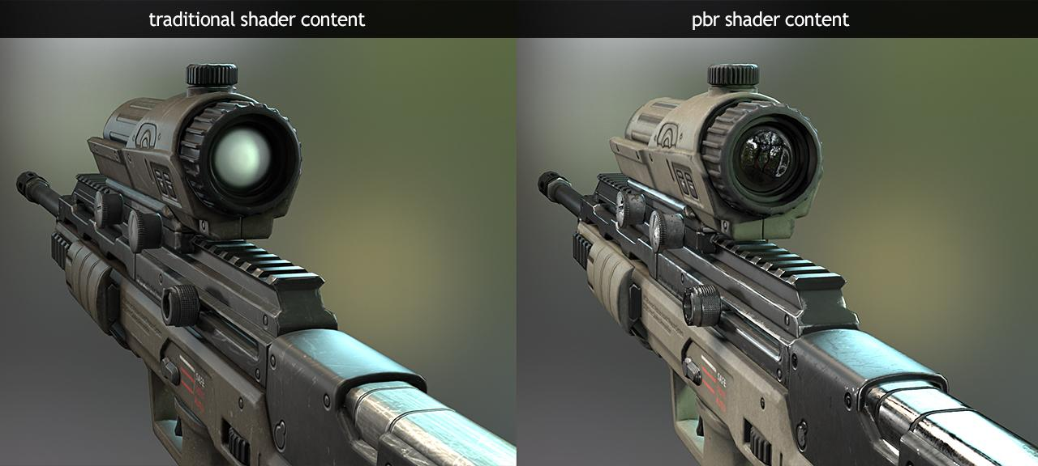
PBR vs non PBR

Slide 3
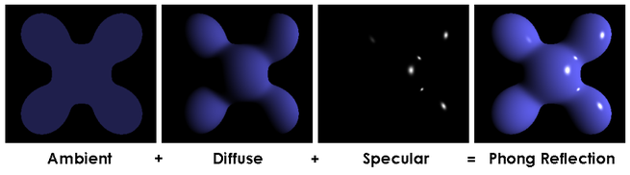
Phong reflection model

Slide 4
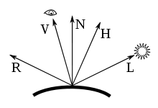
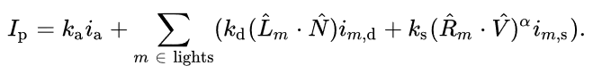
Phong reflection model

Slide 5
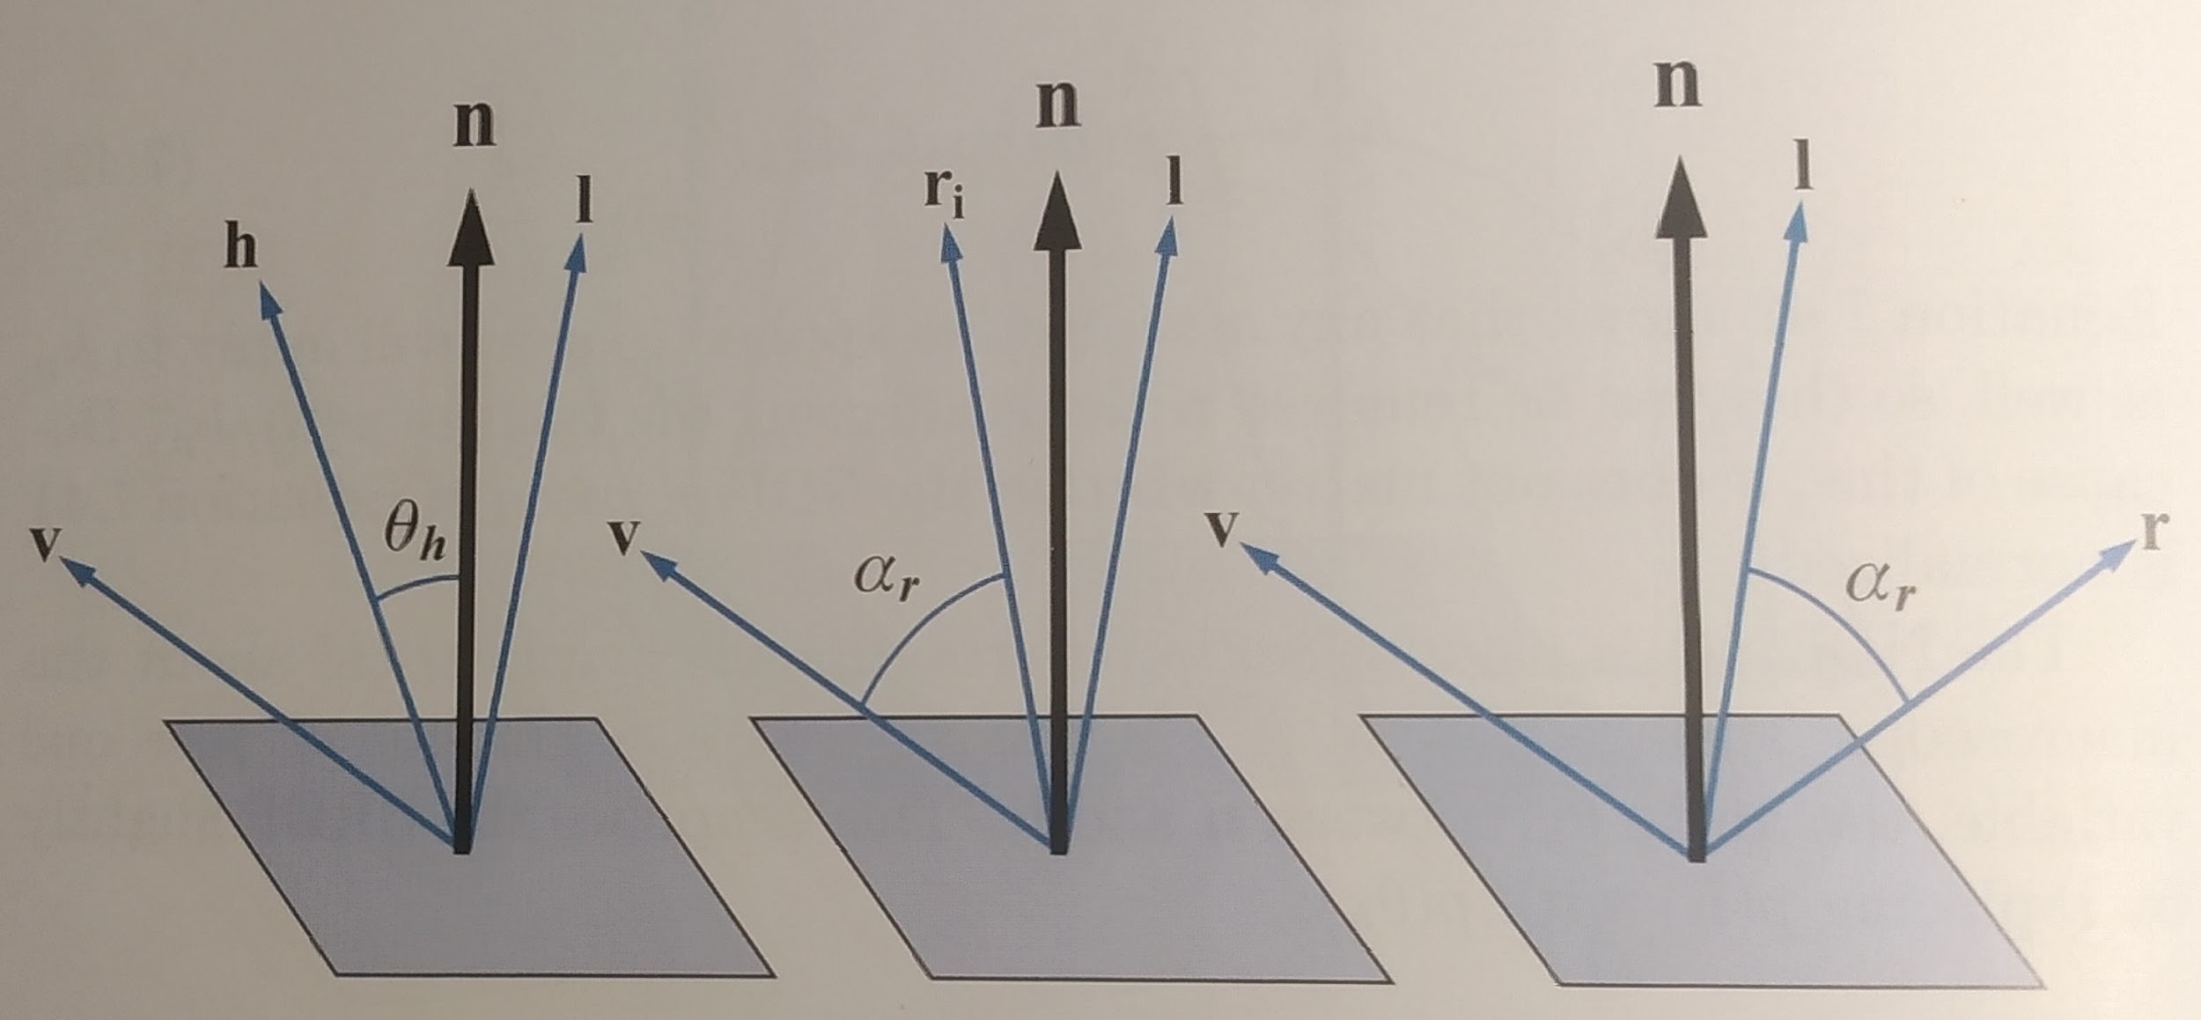
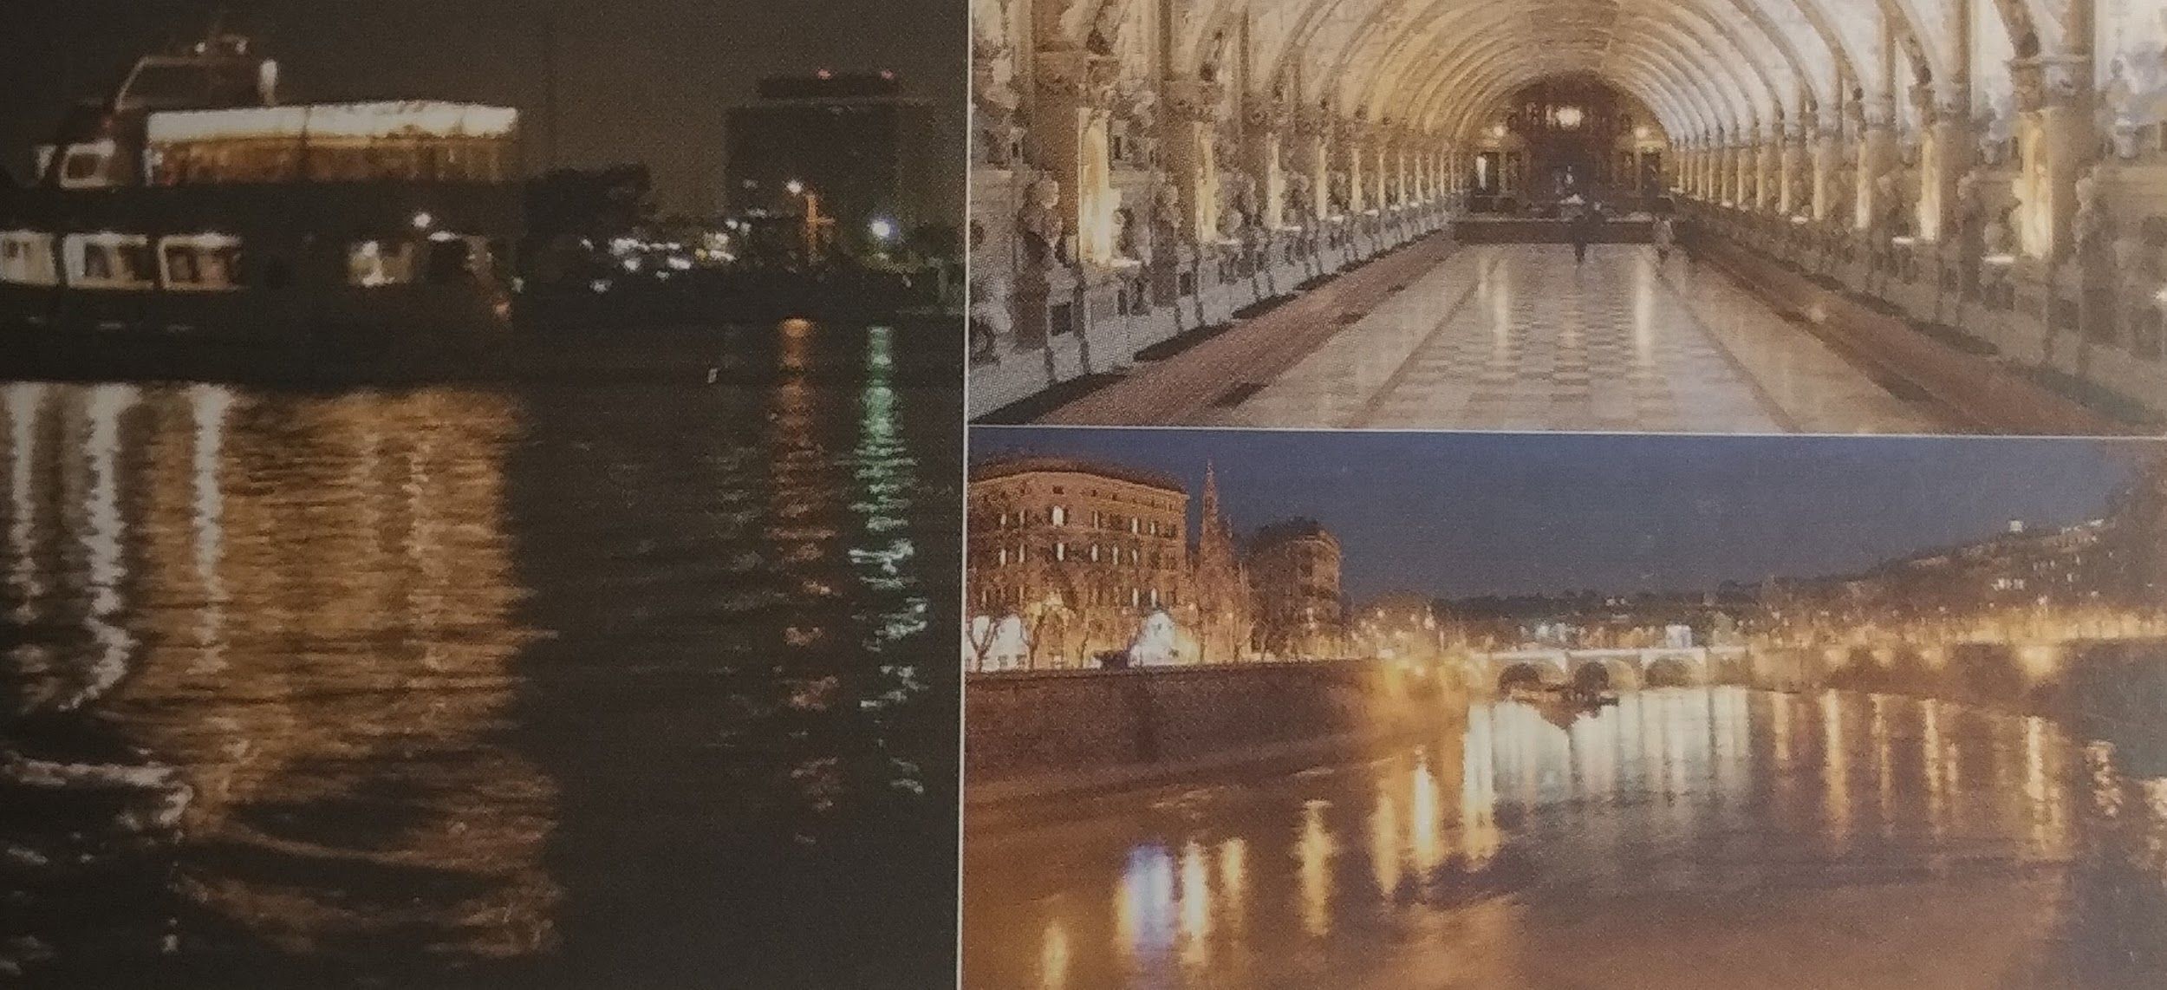
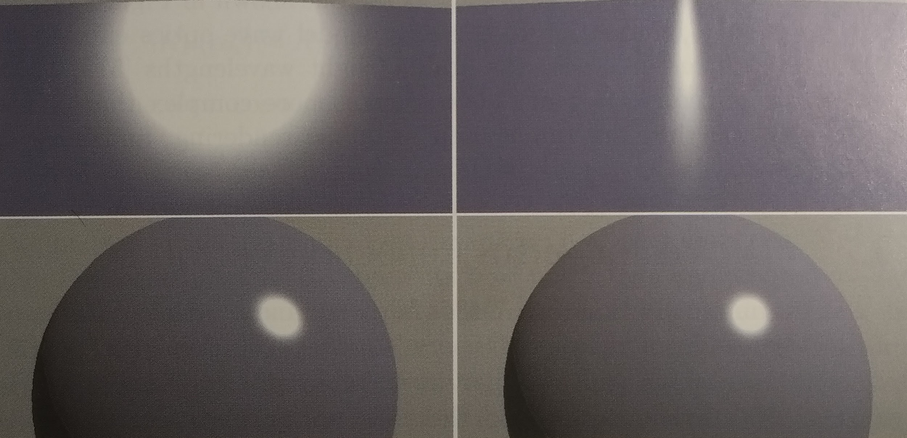
Angle used for specular reflection
Angle between r and v
Angle between h and n
Reference images
Specularity computed with r and v
Specularity computed with h and n

Slide 6
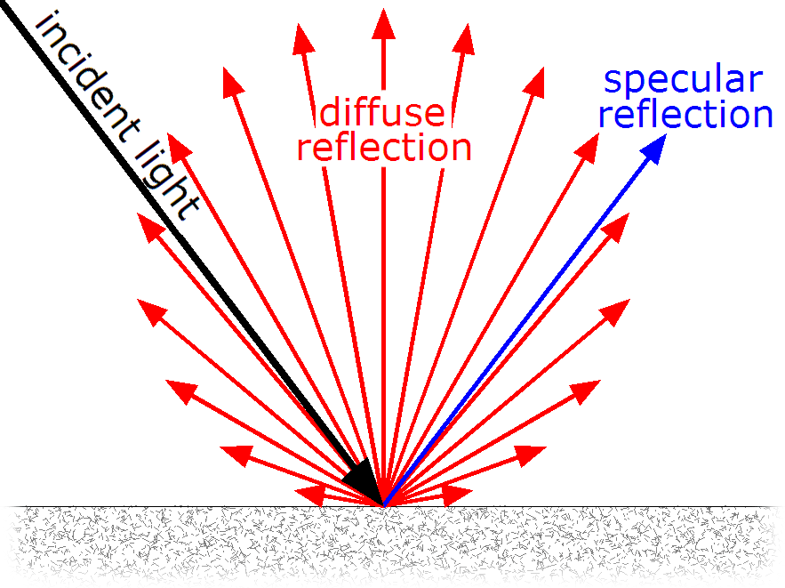
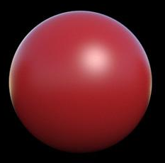
Diffuse and specular reflection

Slide 7
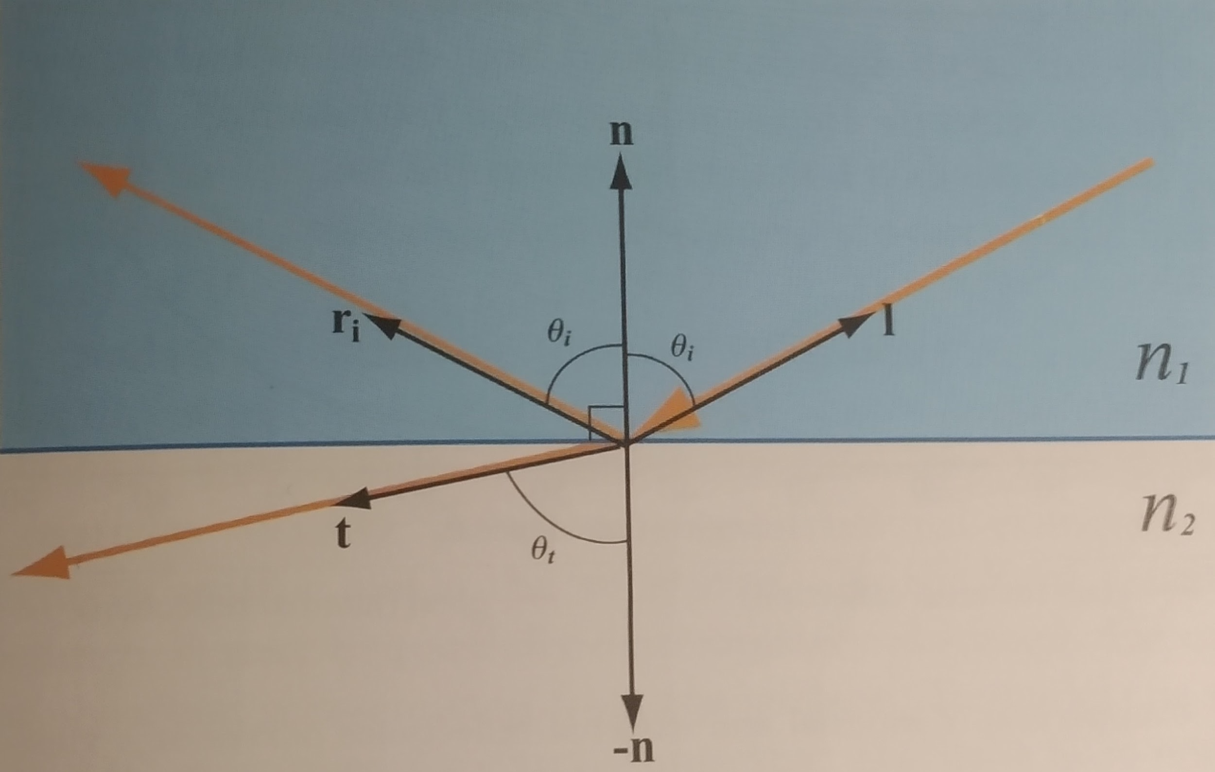
Reflection and refraction

Slide 8
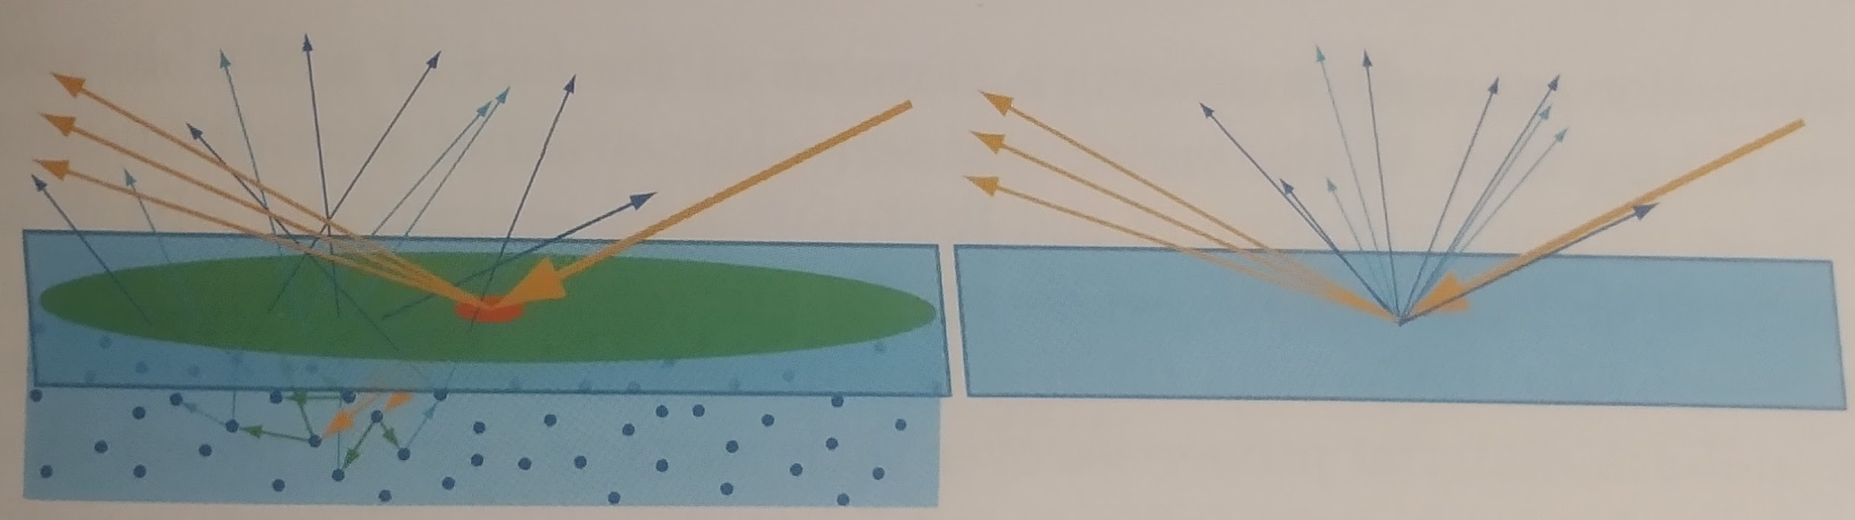
Diffuse reflection

Slide 9
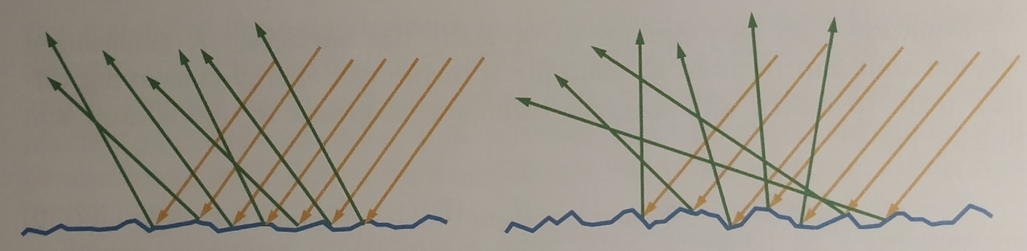
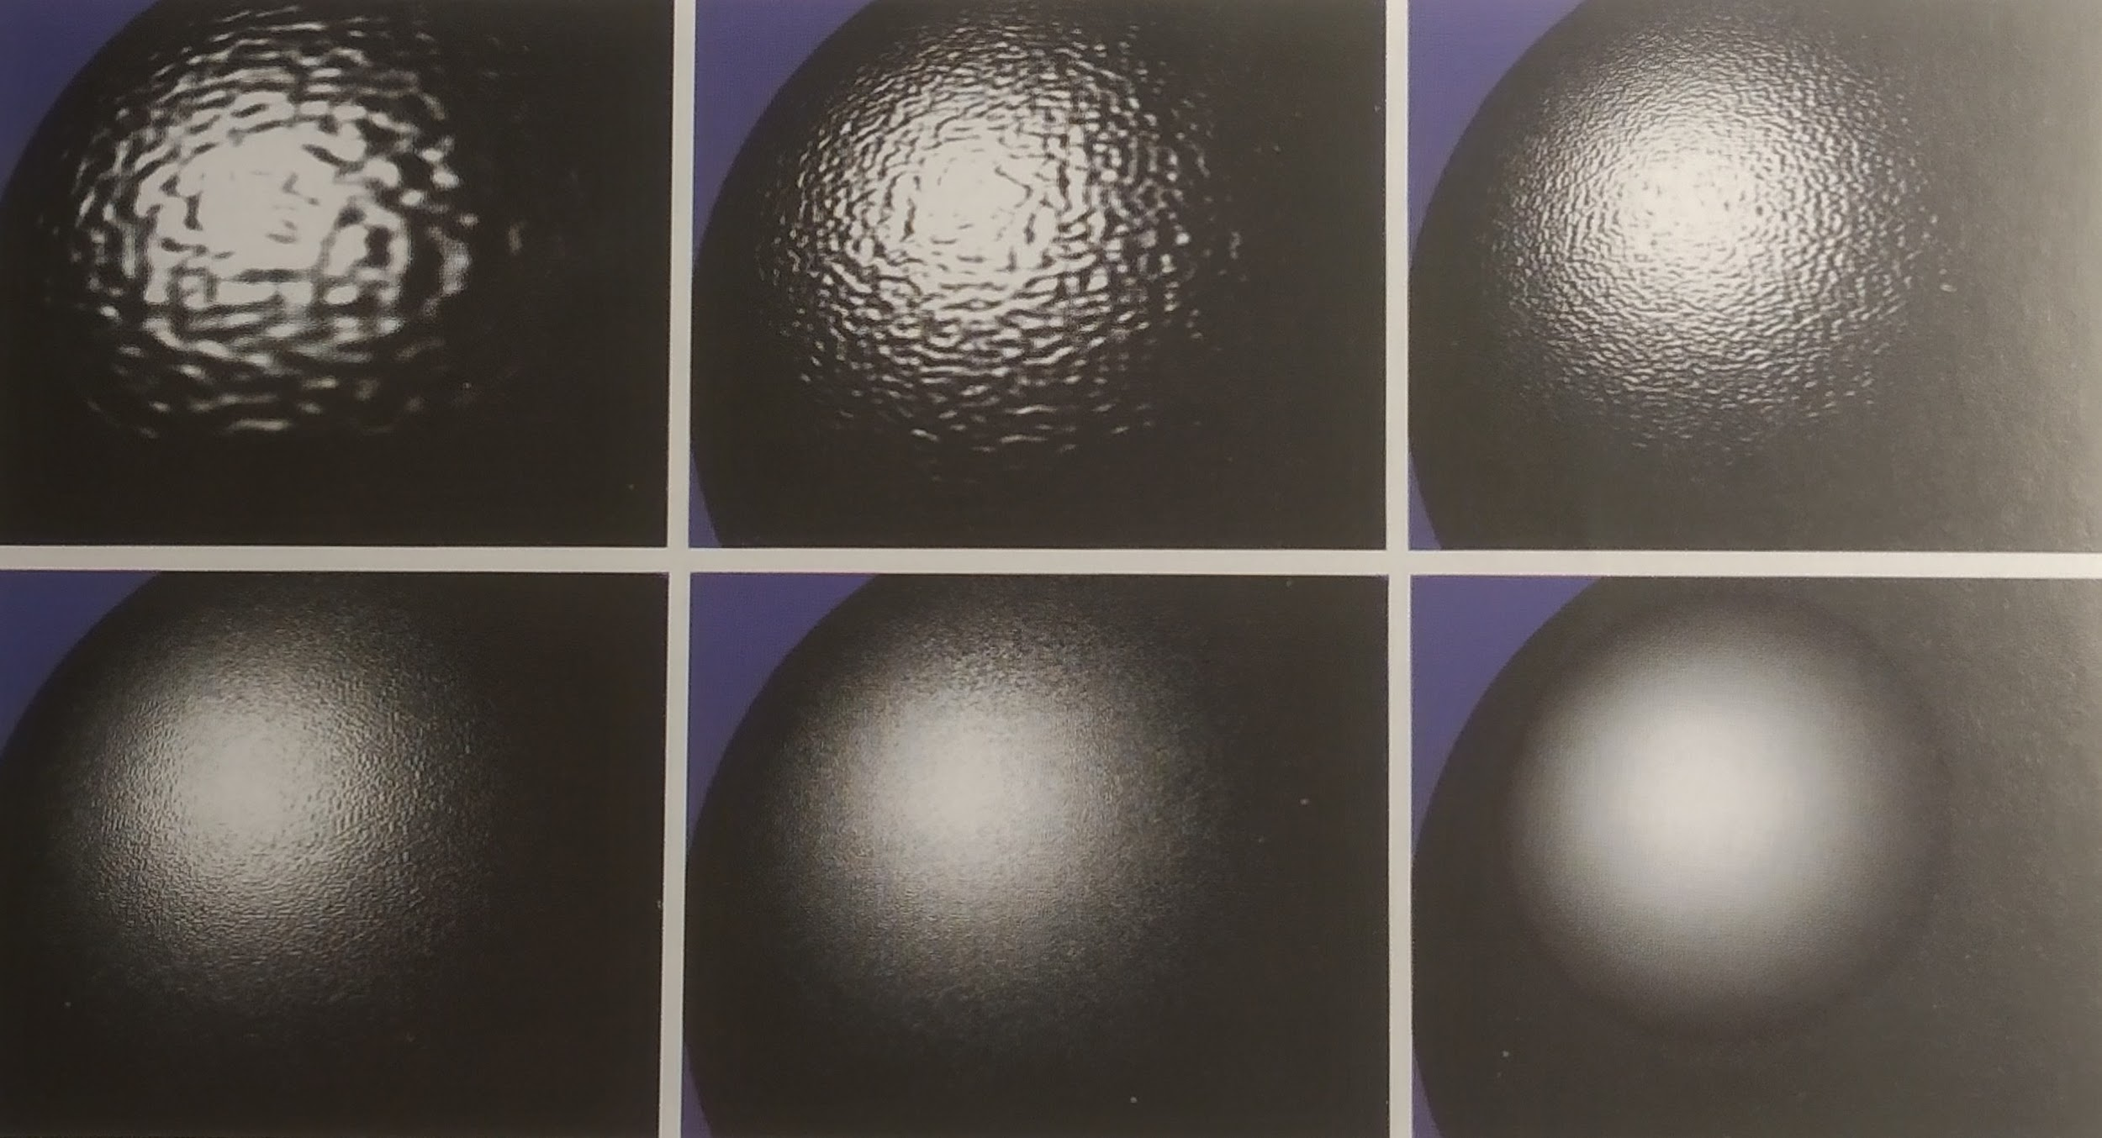
Surface roughness

Slide 10
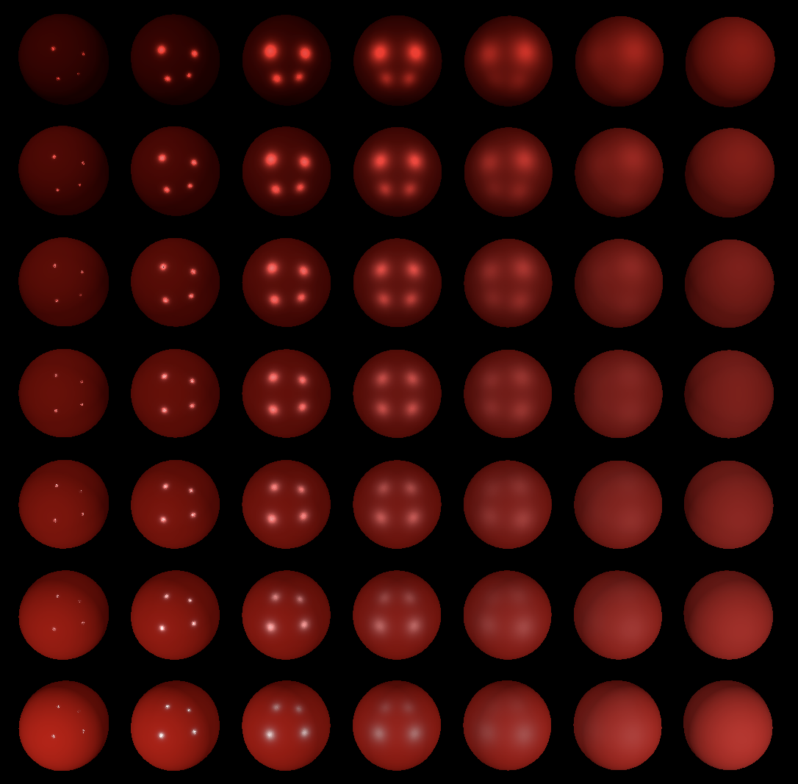
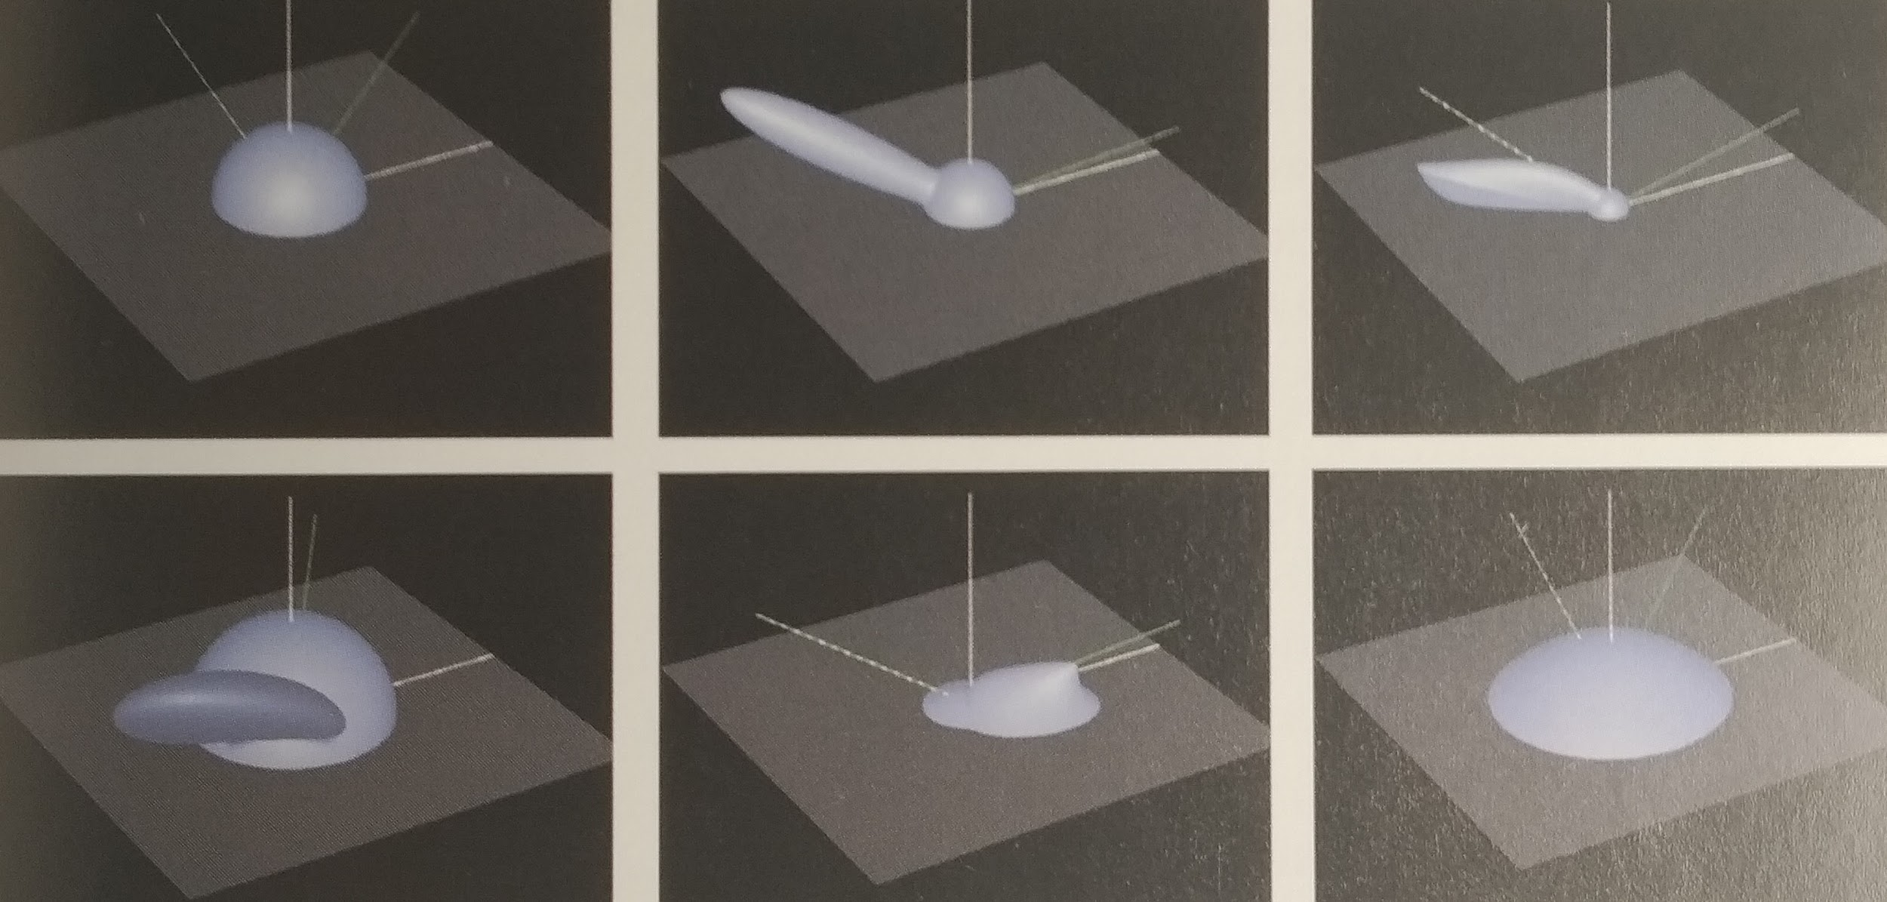
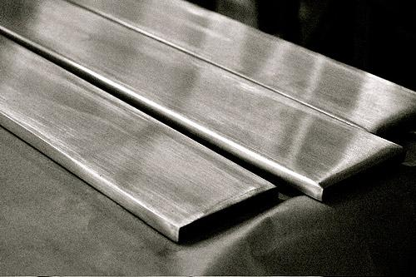
Different types of reflections (depending on the material)

Slide 11
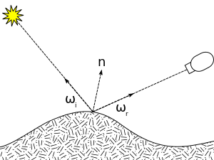
BRDF
(Bidirectional Reflectance Distribution Function)
Defined for a certain material
It tells us how light is reflected
Returns the ratio of reflected light
Main inputs:
Incoming light direction
Outgoing light direction

Slide 12
BRDF
(Bidirectional Reflectance Distribution Function)
Defined for a certain material
It tells us how light is reflected
Returns the ratio of reflected light
Main inputs:
Incoming light direction
Outgoing light direction
Phong BRDF
Blinn-Phong BRDF
Empirical models

Slide 13
Physically based BRDF
(Bidirectional Reflectance Distribution Function)
Defined for a certain material
It tells us how light is reflected
Returns the ratio of reflected light
Main inputs:
Incoming light direction
Outgoing light direction
We also need the material properties
Roughness
Base reflectivity (specular color or R0)

Slide 14
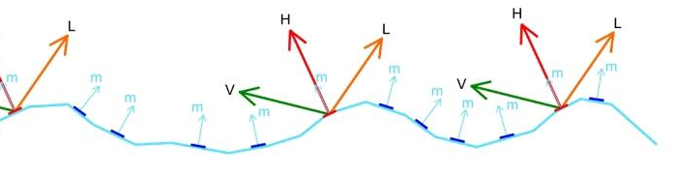
Physically based BRDF
(Bidirectional Reflectance Distribution Function)
Defined for a certain material
It tells us how light is reflected
Returns the ratio of reflected light
Main inputs:
Incoming light direction
Outgoing light direction
We also need the material properties
Roughness
Base reflectivity (specular color or R0)
Cook-Torrance BRDF
Microfacet model
Perfect mirrors
Specularity

Slide 15
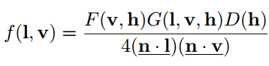
Cook-Torrance BRDF
Physically based BRDF
Only specular highlights
Takes into account
Micro-normal distribution
Geometric occlusion
Fresnel reflectance

Slide 16
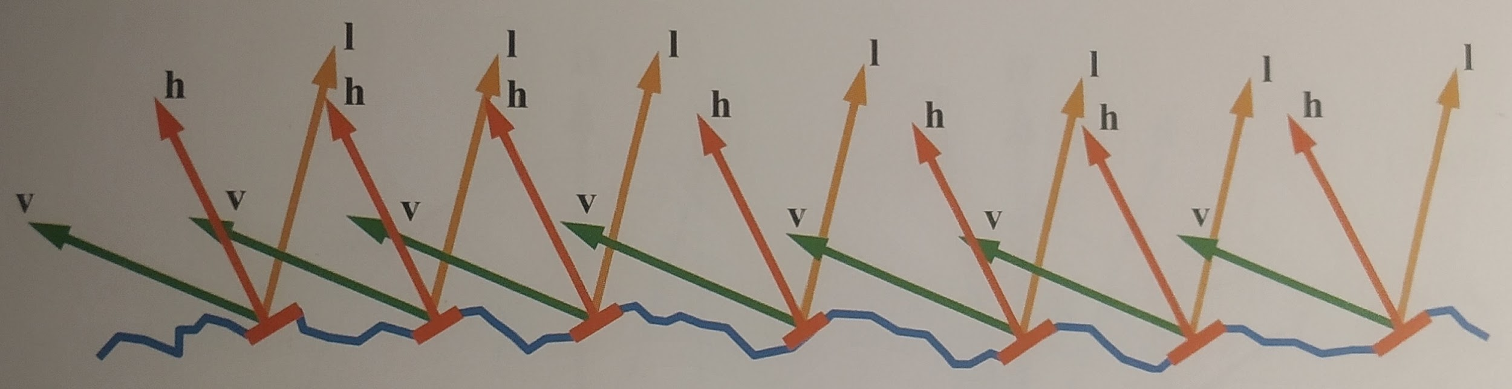
Normal distribution

Slide 17
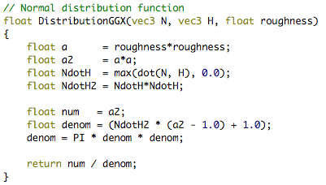
Normal distribution

Slide 18
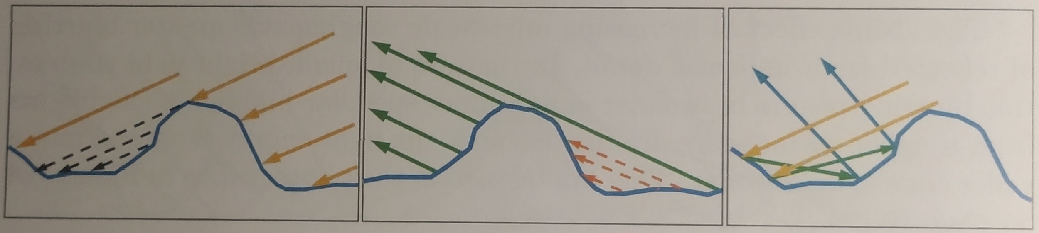
Geometric occlusion

Slide 19
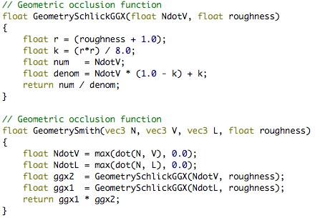
Geometric occlusion

Slide 20
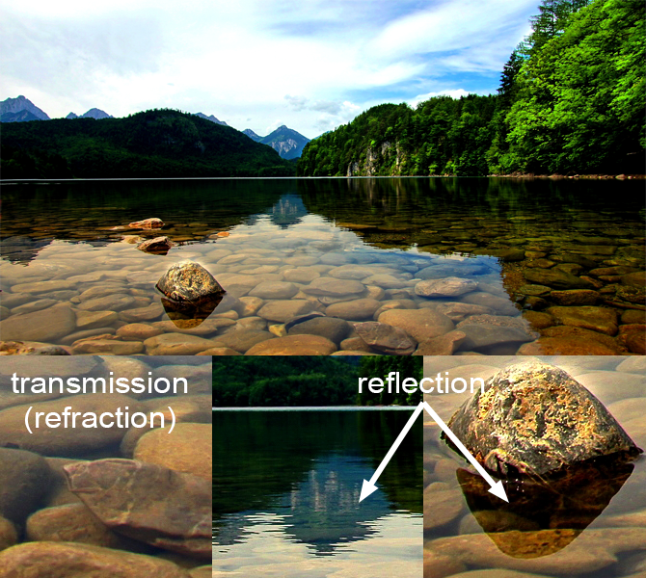
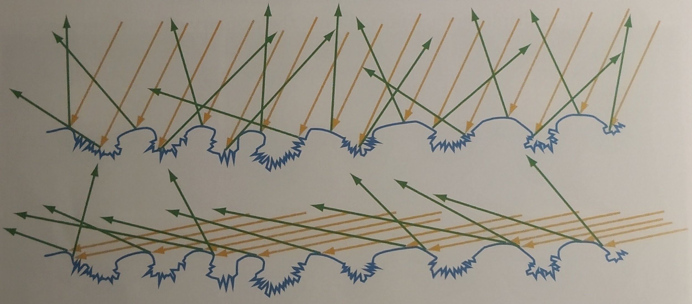
Fresnel reflectance

Slide 21
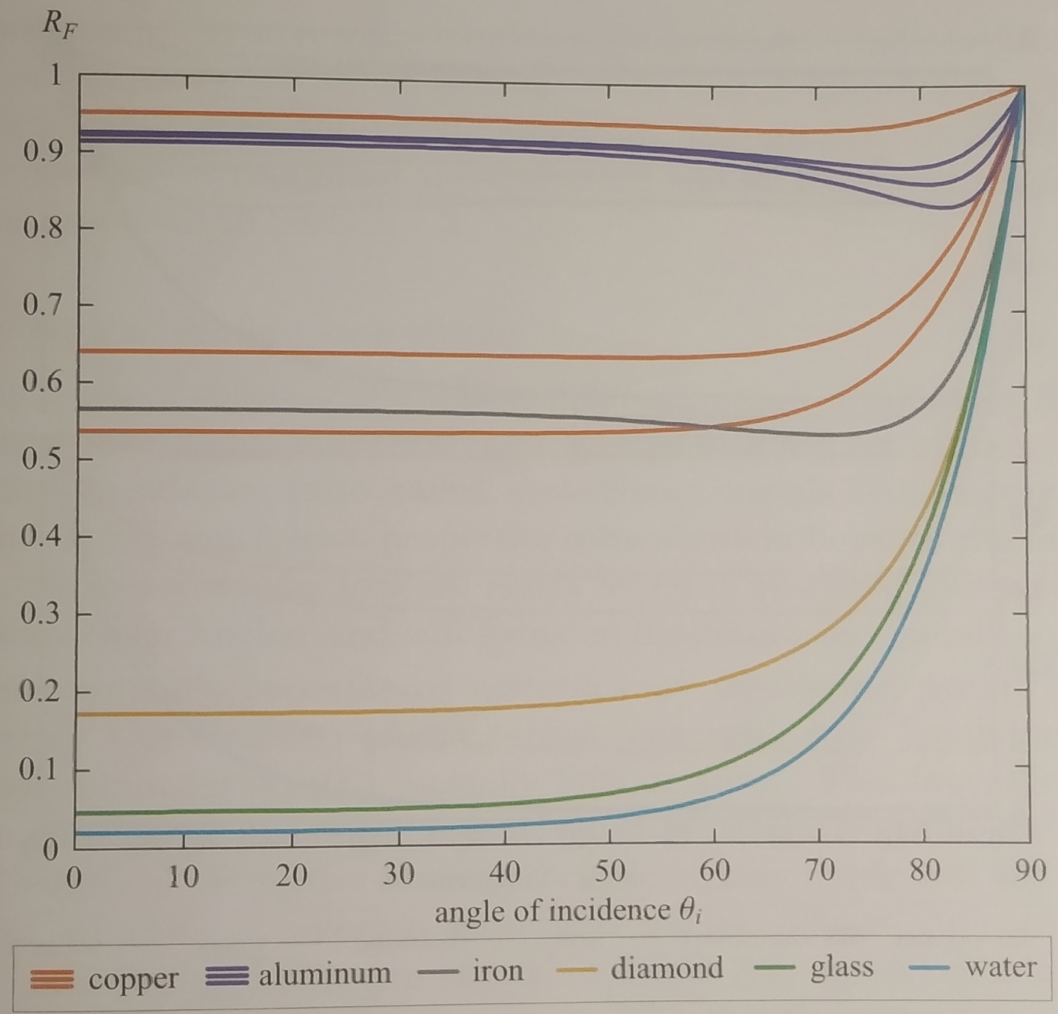
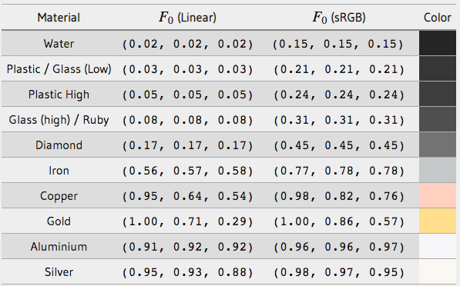
Fresnel function
Fresnel reflectance for different materials

Slide 22
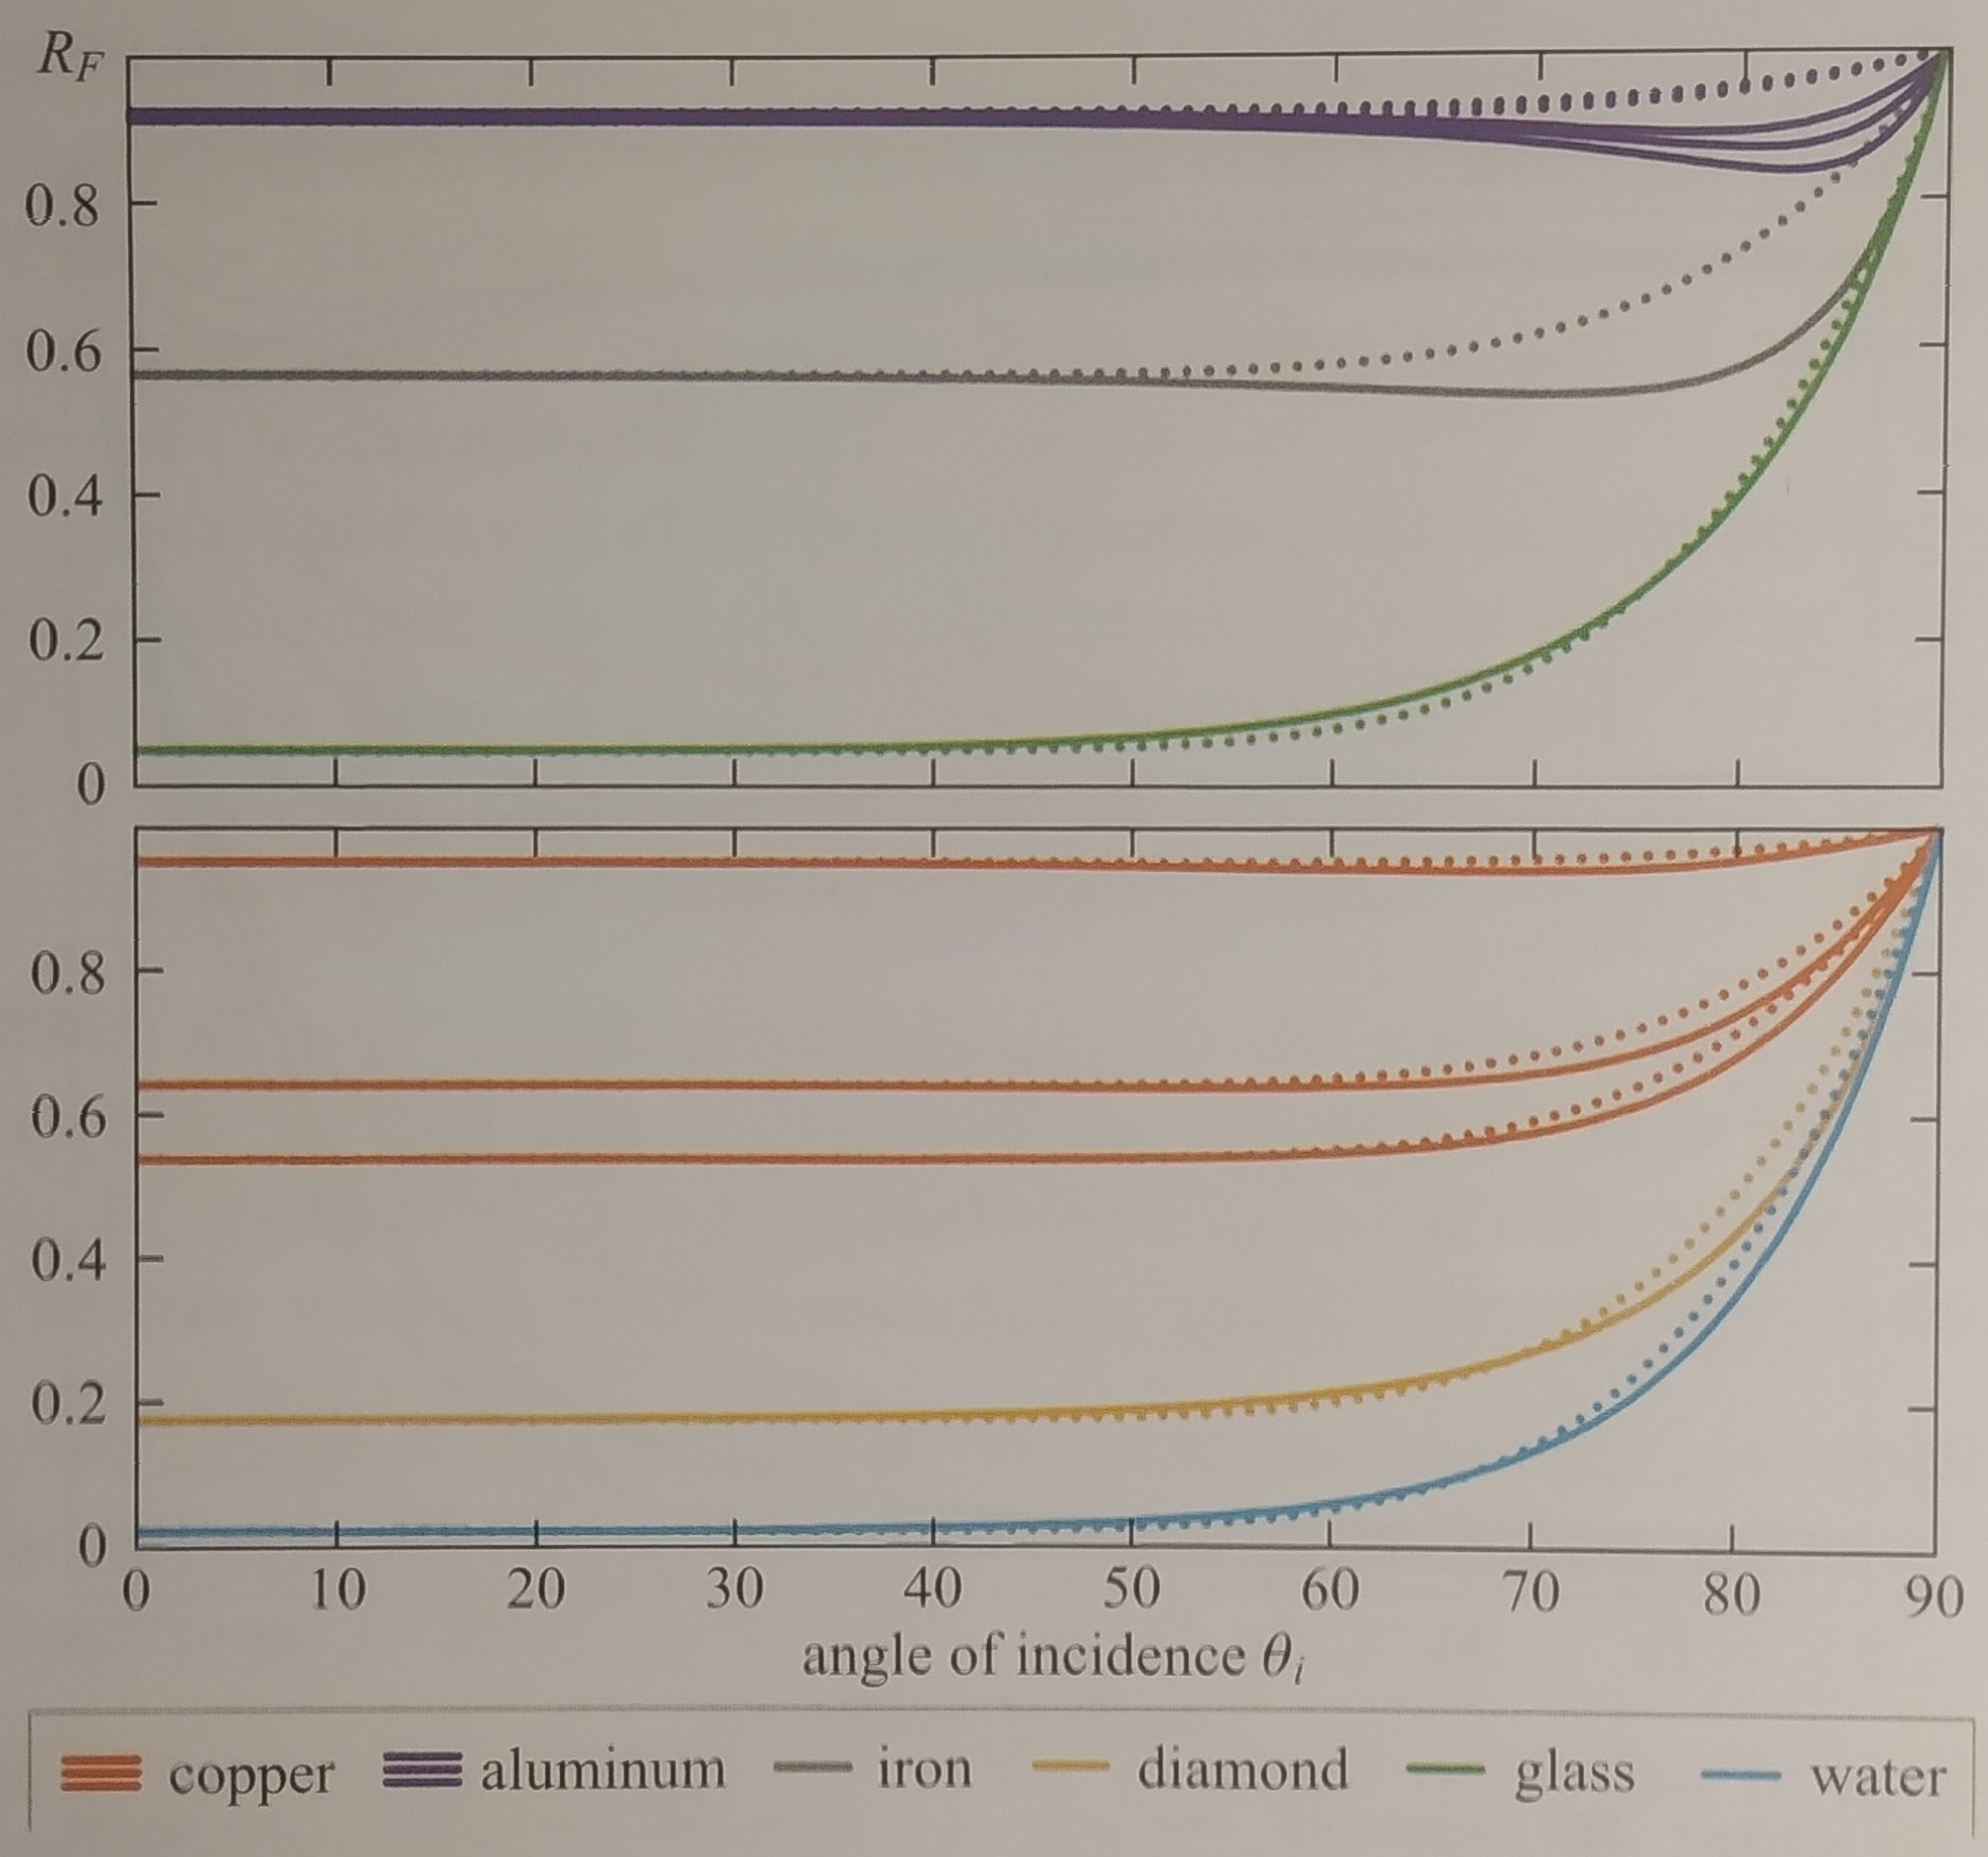
Fresnel function
Fresnel reflectance for different materials
Schlick’s Fresnel function approximation

Slide 23
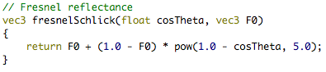
Fresnel function

Slide 24
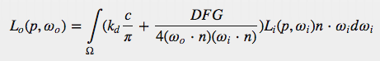
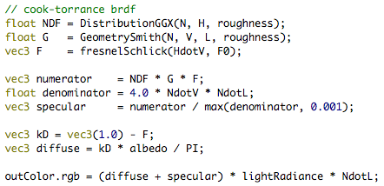
Diffuse reflection using Cook-Torrance BRDF

Slide 25
1
Metallic
Affects base reflectivity (F0)
0
0
Roughness
1

Slide 26
Cook-Torrance BRDF
This is OK for analytic light sources
Limited set of directions
What about environment lighting
Light coming from an image
Nearly an infinite number directions

Slide 27
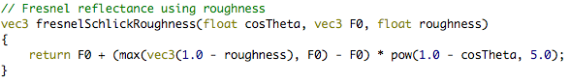
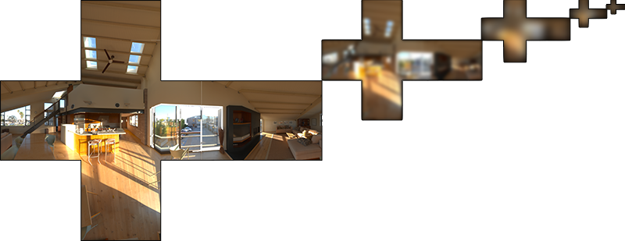
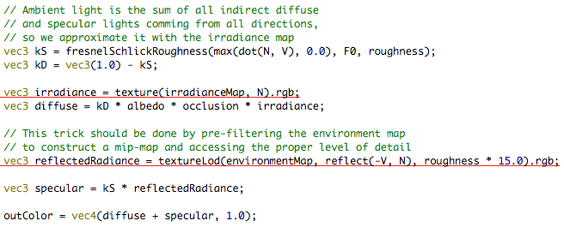
Cook Torrance + environment lighting (Fake)
irradianceMap
environmentMap with mipmapping

Slide 28
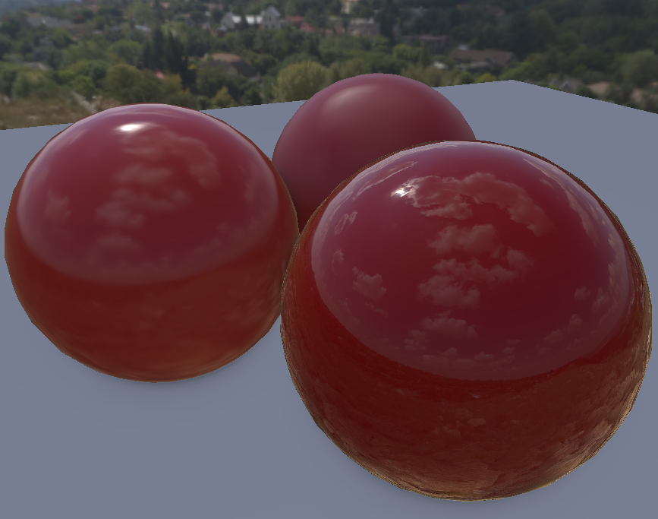
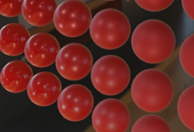
Correct PBR environment lighting
Fake PBR environment lighting

Slide 29
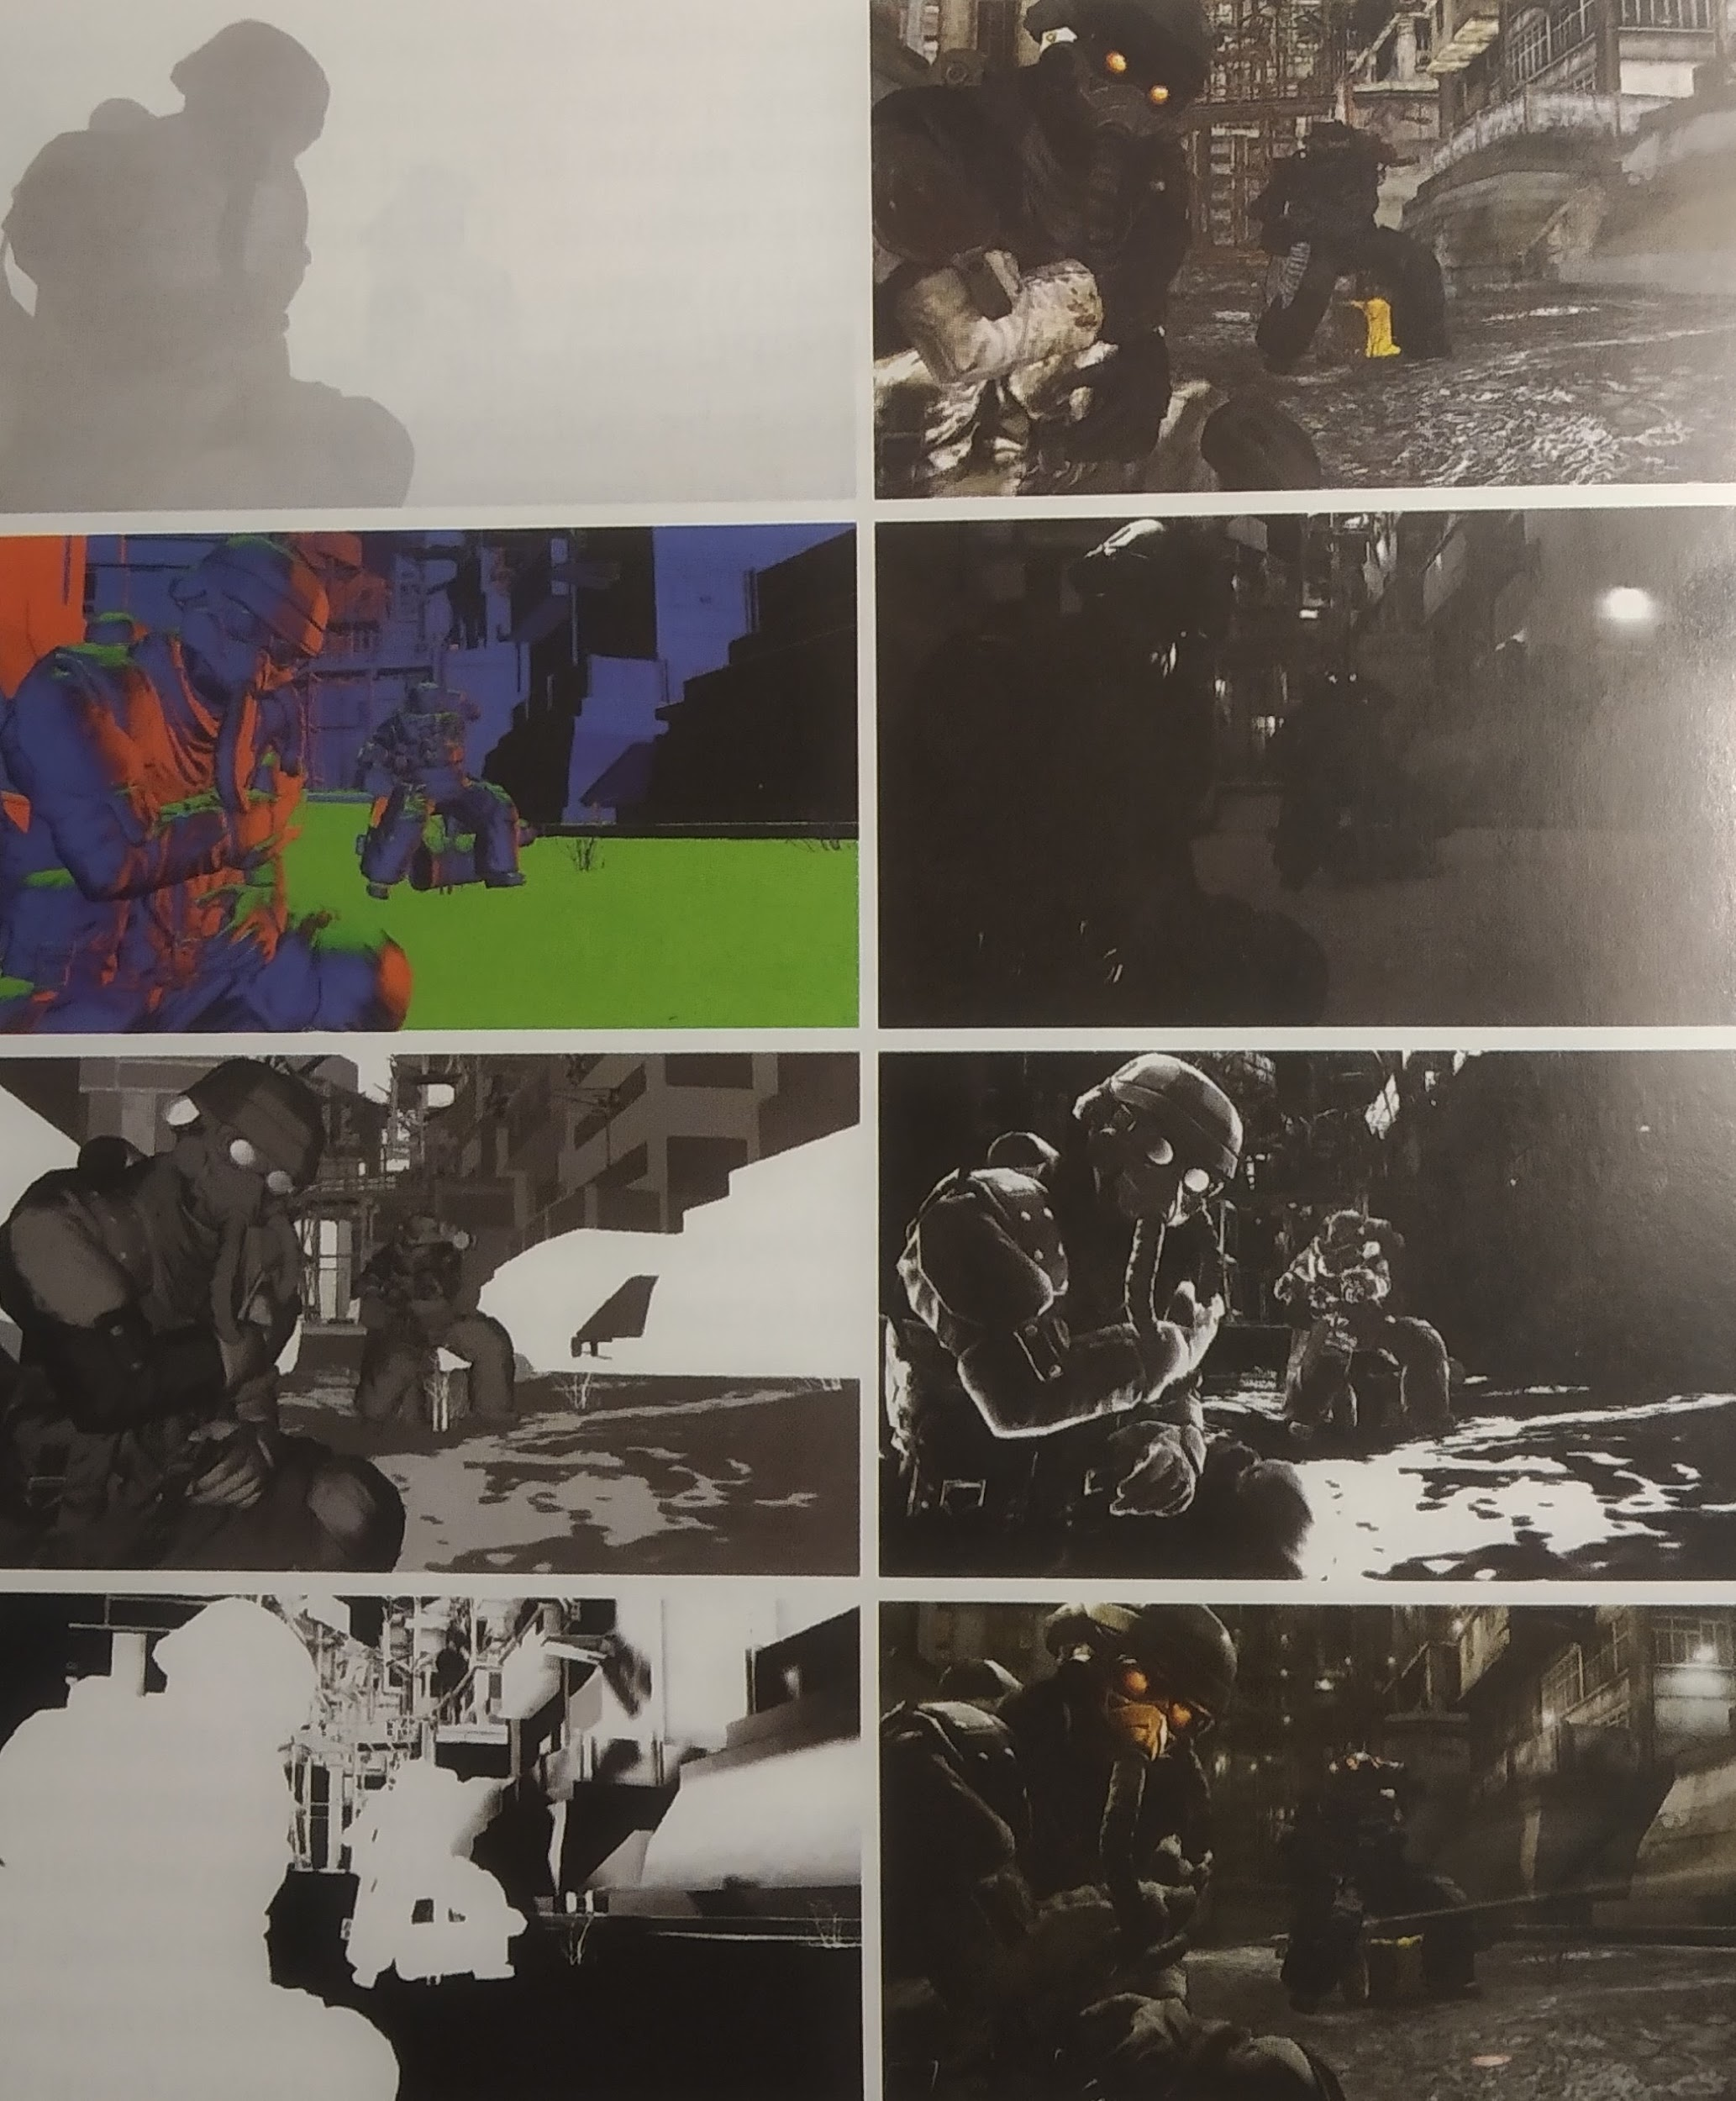
Deferred shading
Base reflectivity (F0)
RGB between 0 and 1
Around 0.04 for dielectrics
Higher, coloured values for metals:
Gold
Copper
Etc
Roughness
Float between 0 and 1

Slide 30
References
Tutorials:
https://learnopengl.com/PBR/Theory
https://learnopengl.com/PBR/Lighting
https://learnopengl.com/img/pbr/ibl_prefilter_map.png
Papers:
http://inst.cs.berkeley.edu/~cs294-13/fa09/lectures/cookpaper.pdf

Slide 31

Questions?

